Slide 1
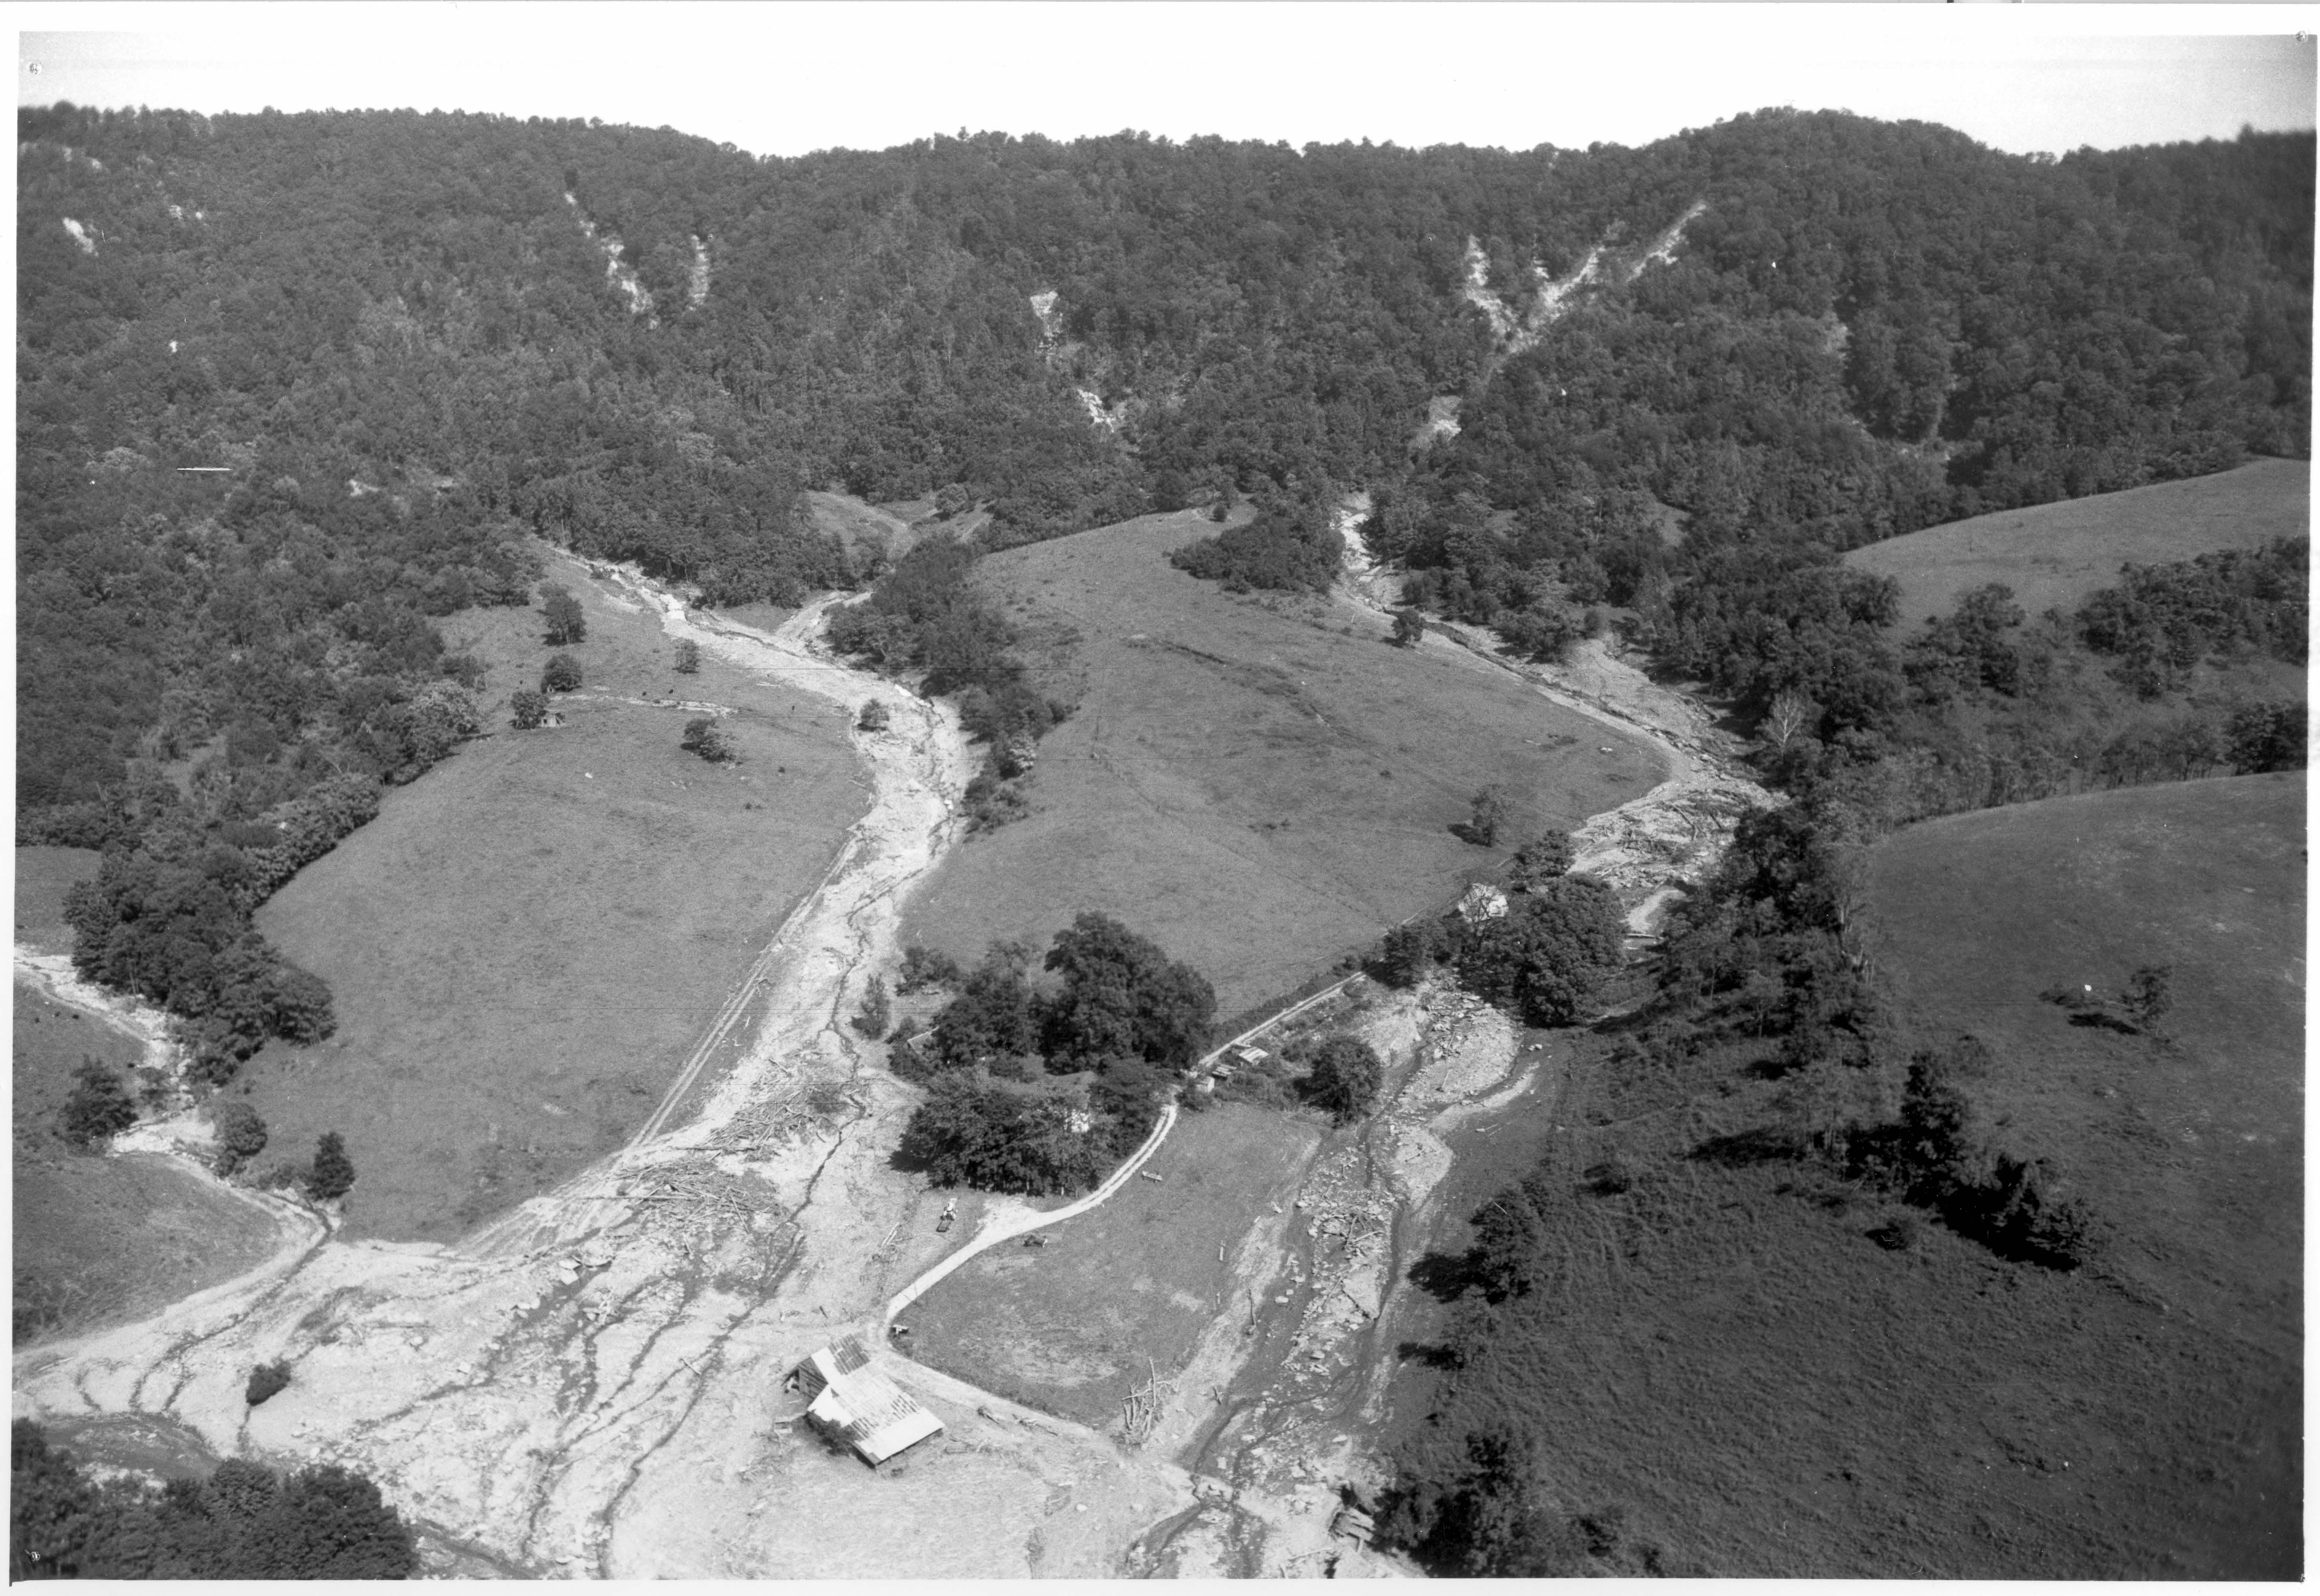
Classifying Landslides Using LiDAR-based DEMs
Virginia Latane

Slide 2
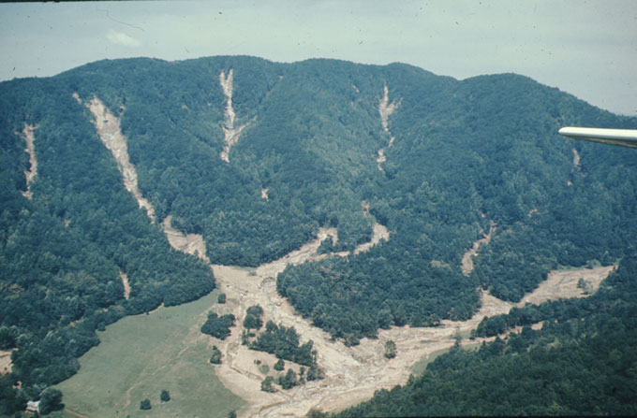
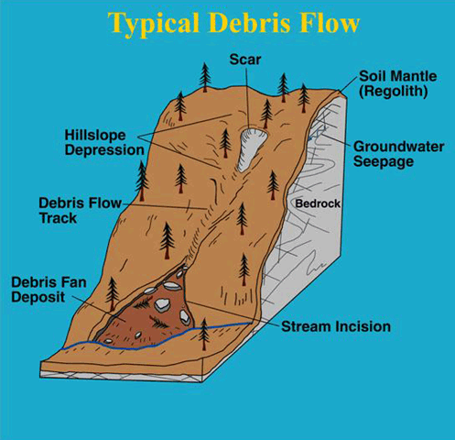
Landslide features
Any downslope movement of mass
Typical slides VA Blue Ridge landslides debris flows, some debris slides
Hurricane Camille a major cause in study area (Nelson Co.)

Slide 3
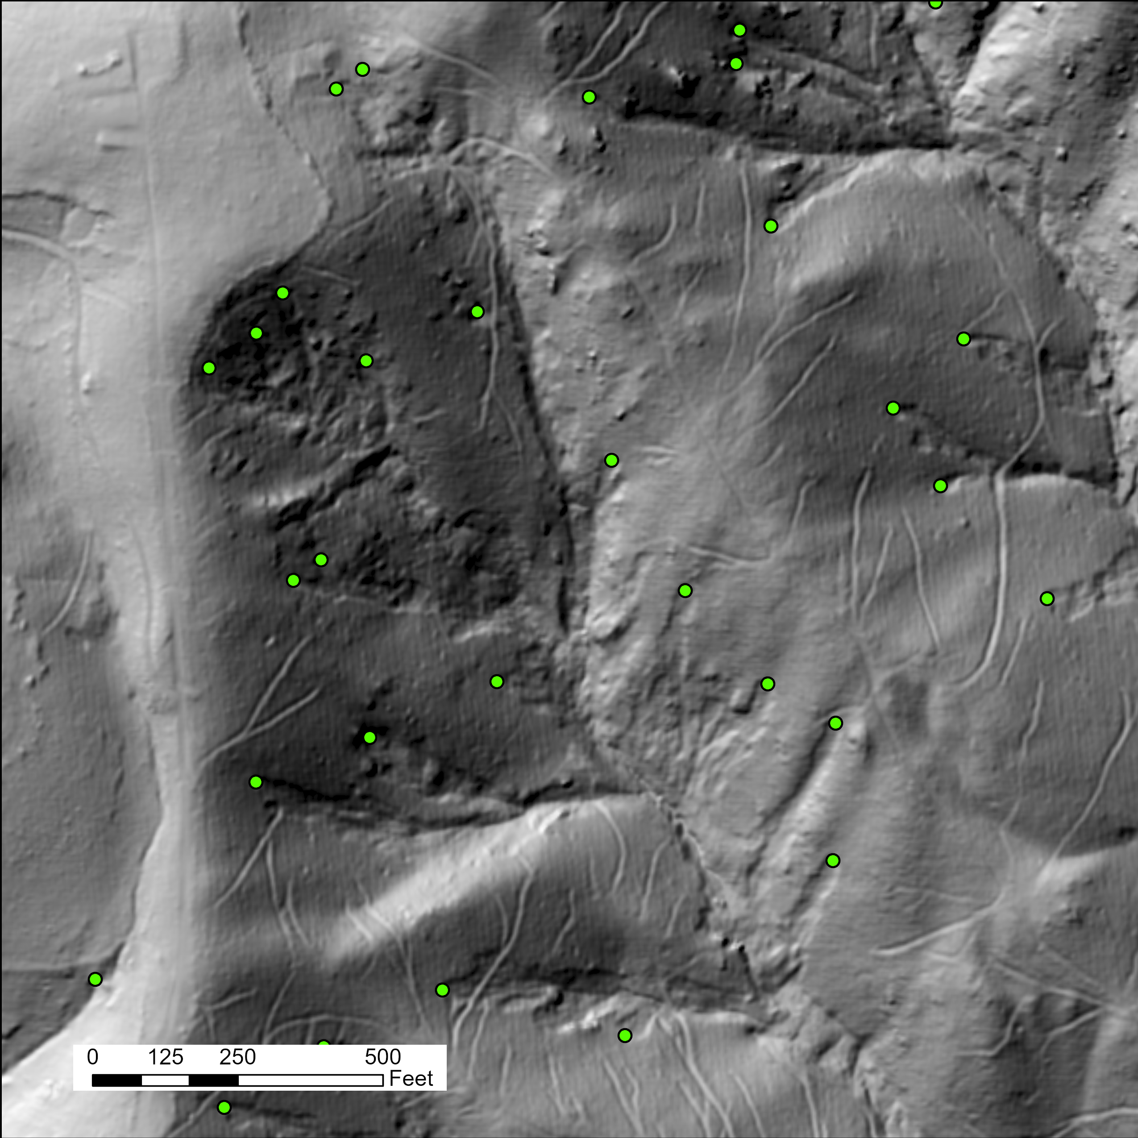

Slide 4
Goal
Produce starting point for a landslide inventory
Inventory is a starting place for landslide prediction and management
Automation will not replace visual interpretation, which can more easily incorporate archival aerial imagery
Classify landslide features using LiDAR based DEMs instead of spectral imagery
Heavily forested areas hide landslides well, especially decades afterward
Change detection another option, but not with multispectral imagery

Slide 5
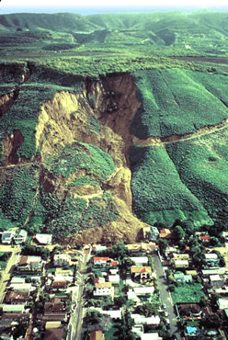
Why?
Landslides are destructive
$2-4 billion worth of property damage annually (U.S.)
Average death toll 25-50 people annually (U.S.)
Landslide modeling way of mitigating the damage pre-emptively. Emergency planners can be better informed.
Why specifically a landslide inventory?
Landslide inventories take a lot of man hours to produce, are more susceptible to human error with inconsistent training.

Slide 6
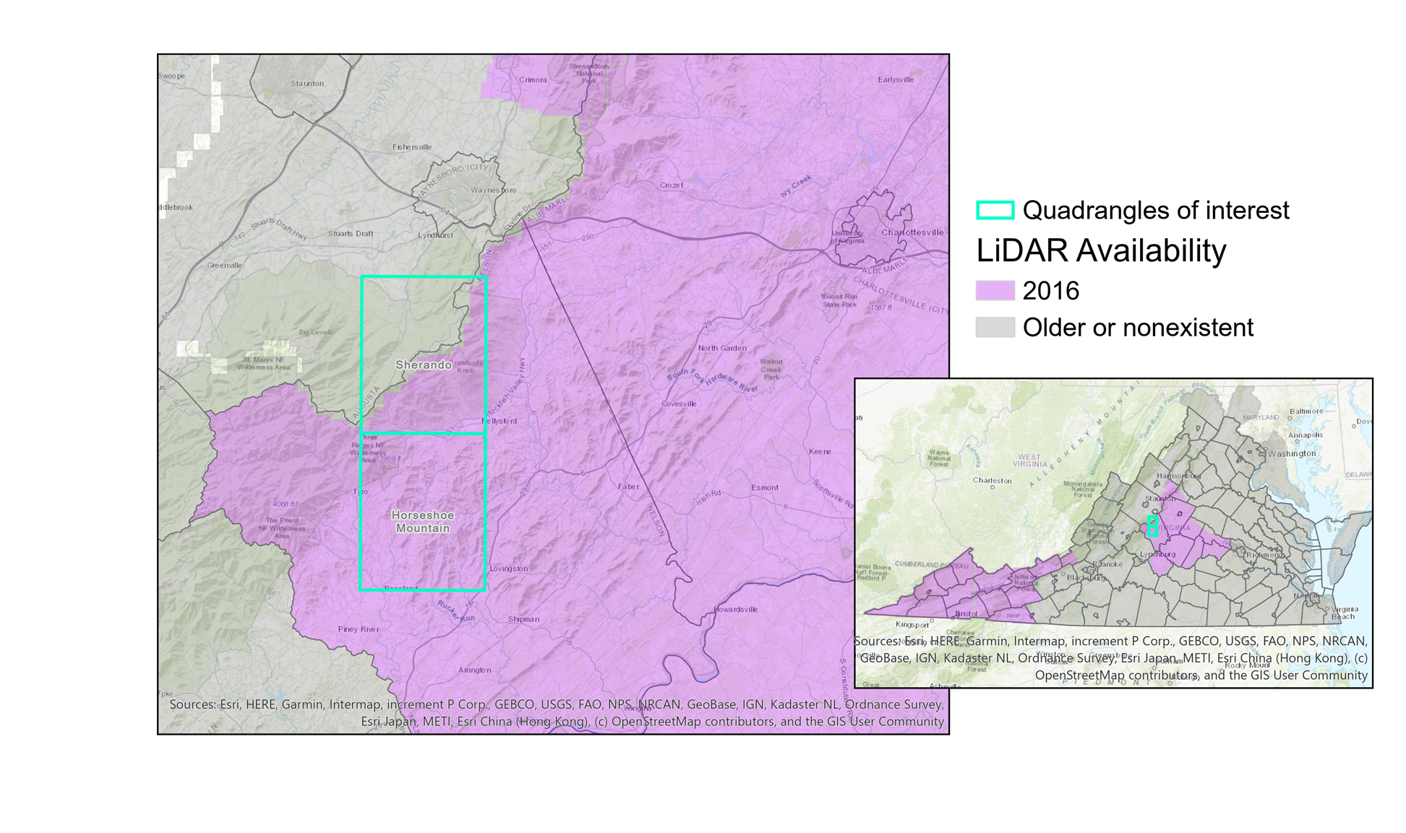
Study area
Extent of 2016 LiDAR within Horseshoe Mountain and Sherando Quads (~90mi²)
Two different quadrangles
Sherando: Flatter, fewer slides
Horseshoe Mtn: Rugged, epicenter of Camille slides
Differences in geologic units not accounted for in this study

Slide 7
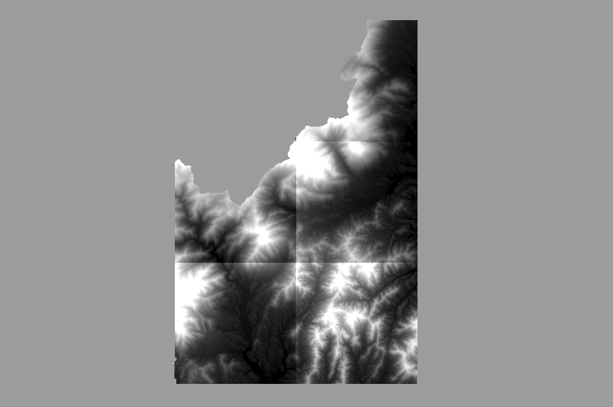

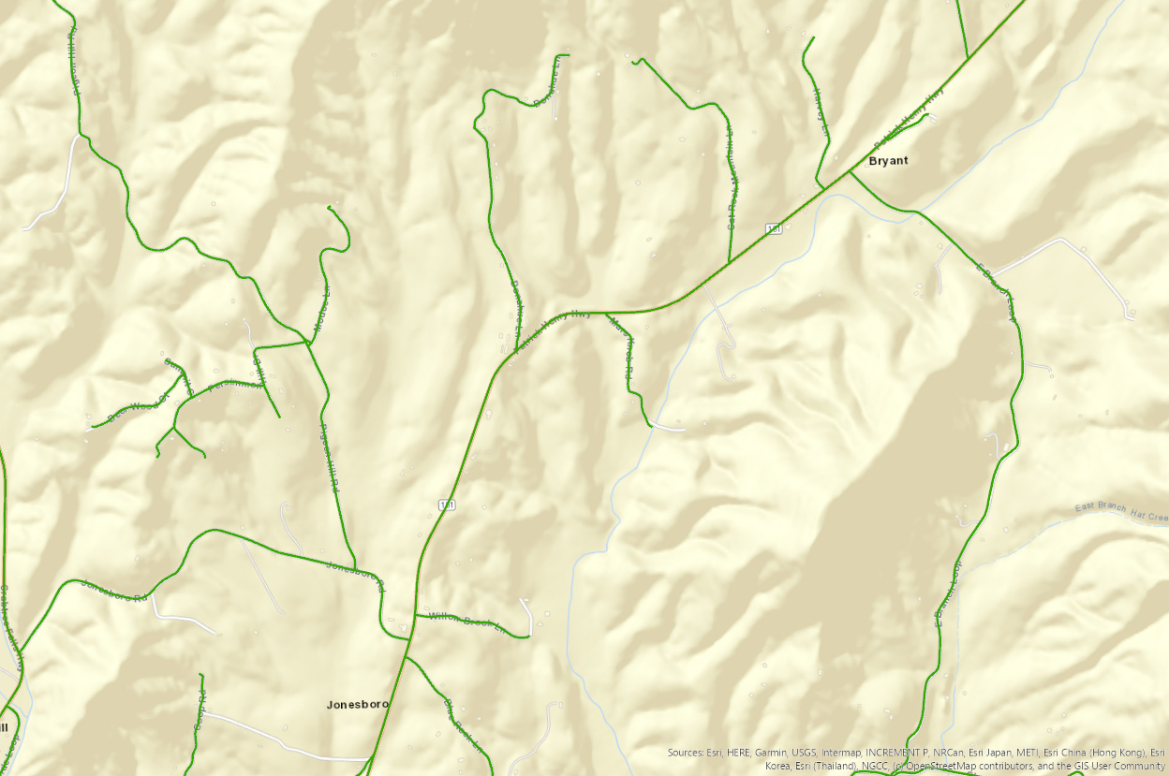
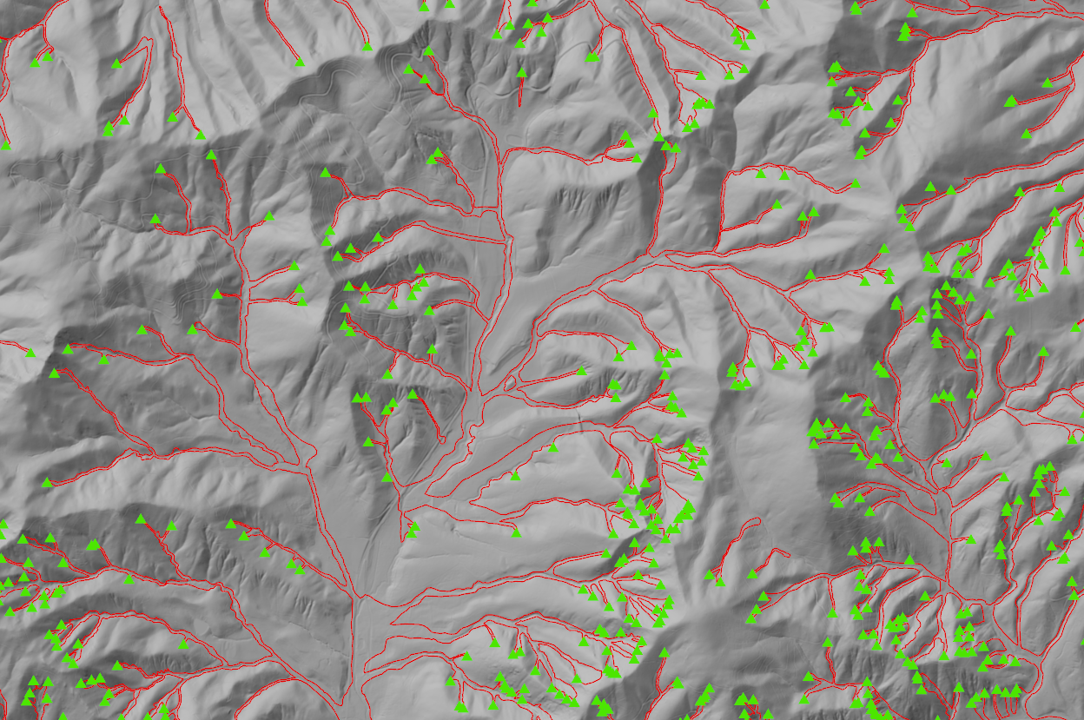
Data
2016 Lidar DEMs from USGS TNM (preprocessed)
River flowlines (NHD)
Virginia road centerlines (VGIN VBMP)
Virginia DMME landslide features process points and slope movement outlines

Slide 8
Methodology
1. Mosaic, clip all data layers to study area
2. Produce DEM-derivatives, rasters in ArcGIS:
Slope
Surface roughness (SD Slope)
Curvature (Standard)
Aspect
Hillshade
Rivers (Raster generated from flow direction, accumulation)
Road density
3. Create multi-raster composite
4. Run a supervised classification with composite
Adjust training samples from slope movement outlines for landslide features (save 30% for validation)
Repeat and adjust classification as needed
5. Validate and assess results
*Bonus: Calculate which class predominates at certain distances from roads and rivers
Notes:
Curvature is good for picking out the unique shape of head scarps
Surface roughness – different geomorphic features theoretically have unique patterns of variability in slope

Slide 9
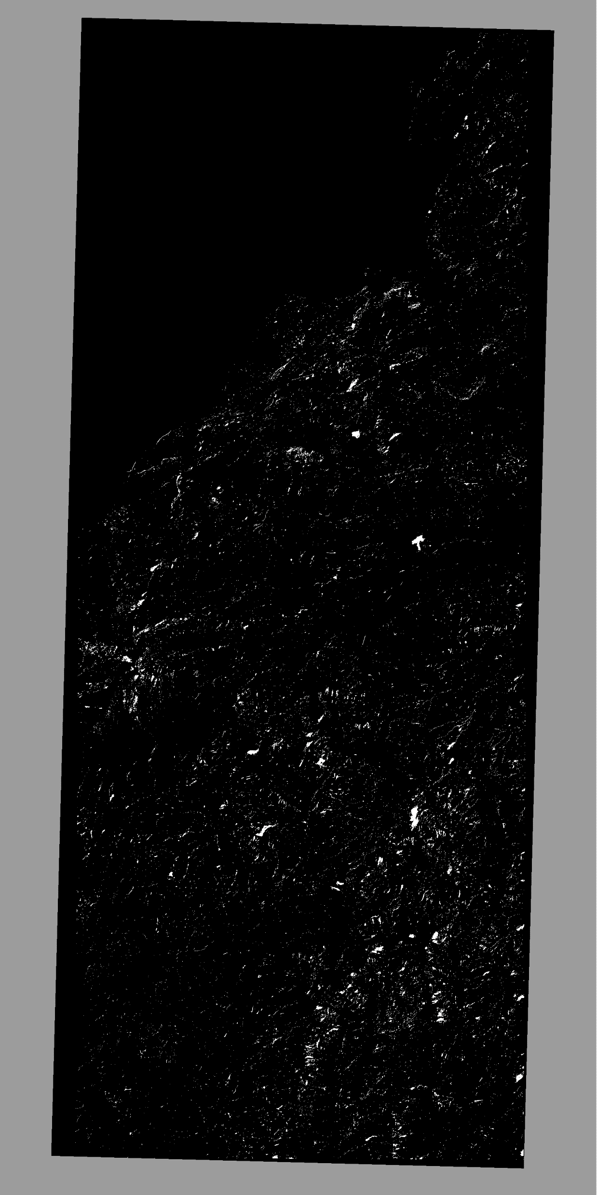
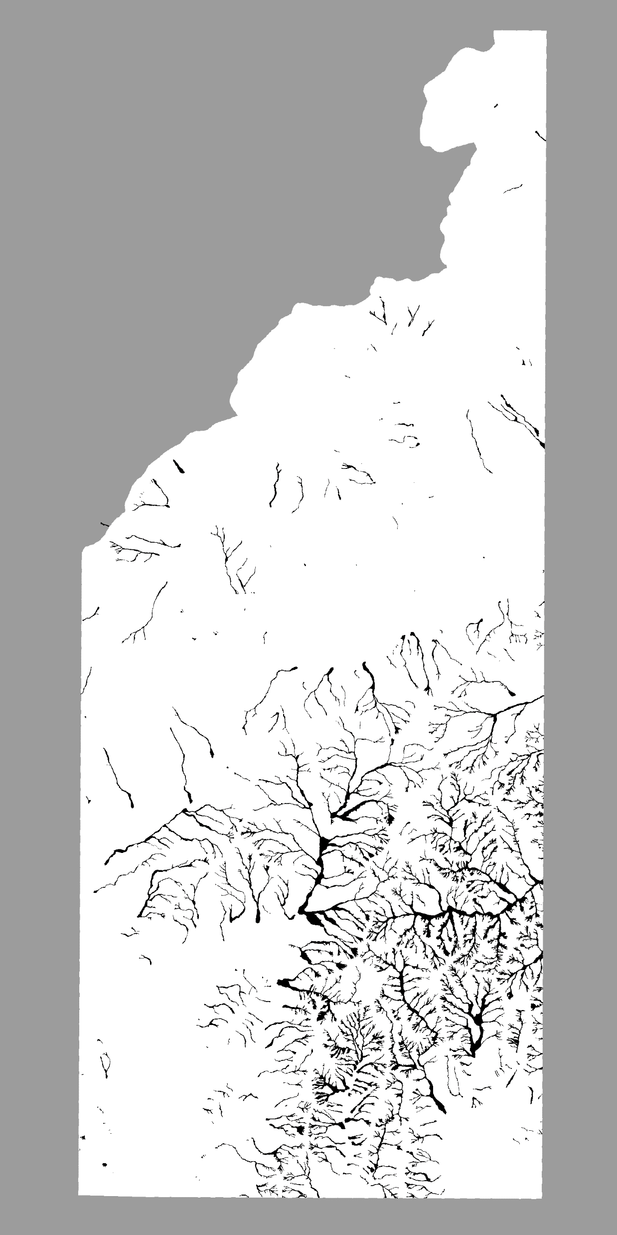
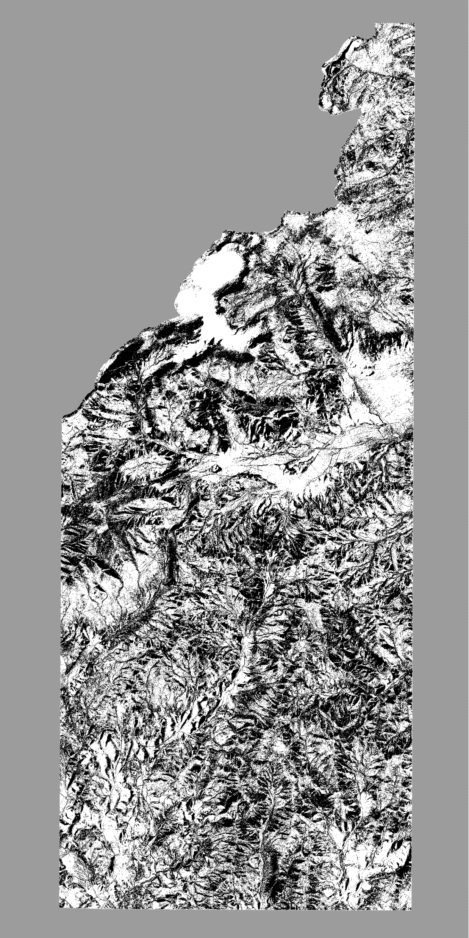
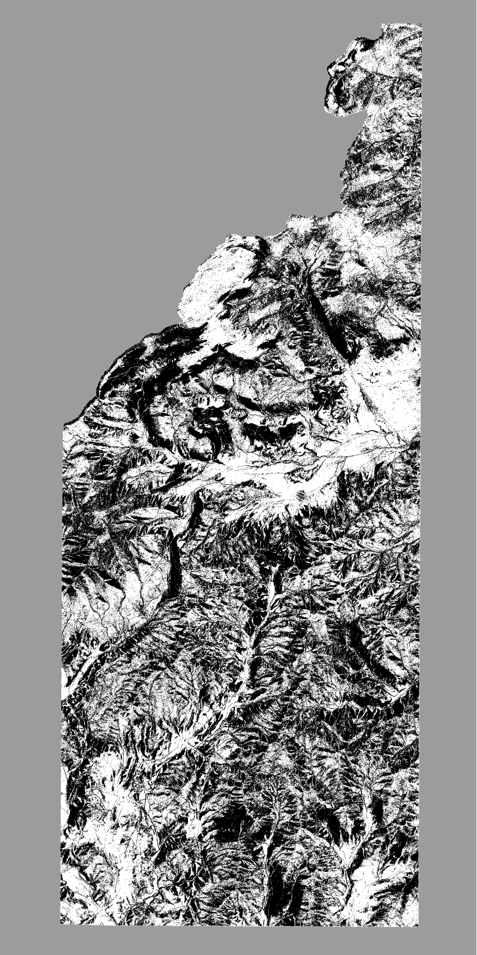
1
idealized
2
3
Notes:
1st: pretty much random – segmentation and statistically variable training samples. Also based on ONLY the HILLSHADE. This one was about getting through the mechanics
2nd – improved. No segmentation

Slide 10

Results
Errors of Omission: 71.9% of landslide test pixels were correctly classified (28.1% incorrect)
Accuracy for 30% of the original slope movement outlines polygon feature class
Errors of Commission: 52.5% of non-landslide pixels were correctly classified (47.5 incorrect)
Accuracy for all pixels that do not belong to any polygon, training or test
91% of process points classified as landslide across entire map

Slide 11
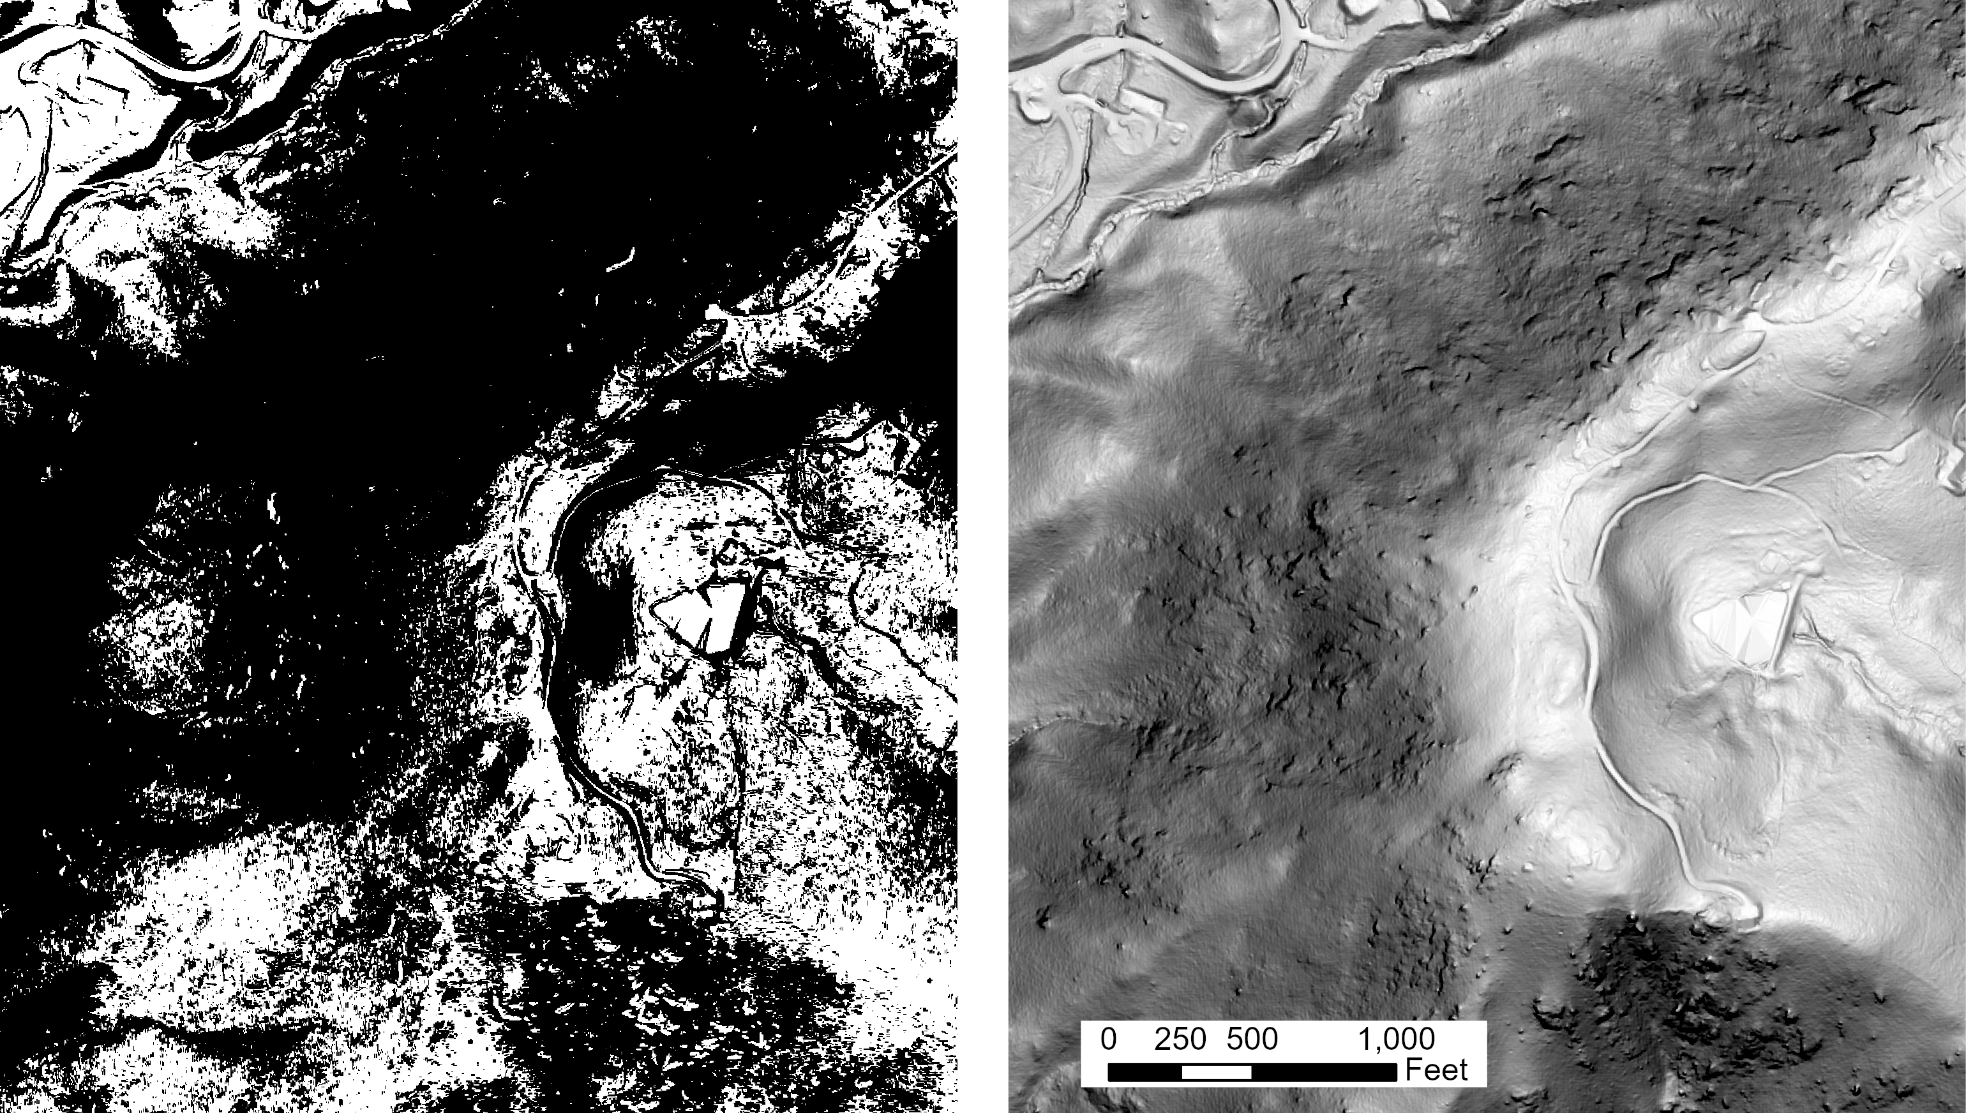
Results
Qualitatively, Sherando has a greater percentage of false positives than Horseshoe Mountain
Often appear across laterally continuous areas
Here, could be textural confusion

Slide 12
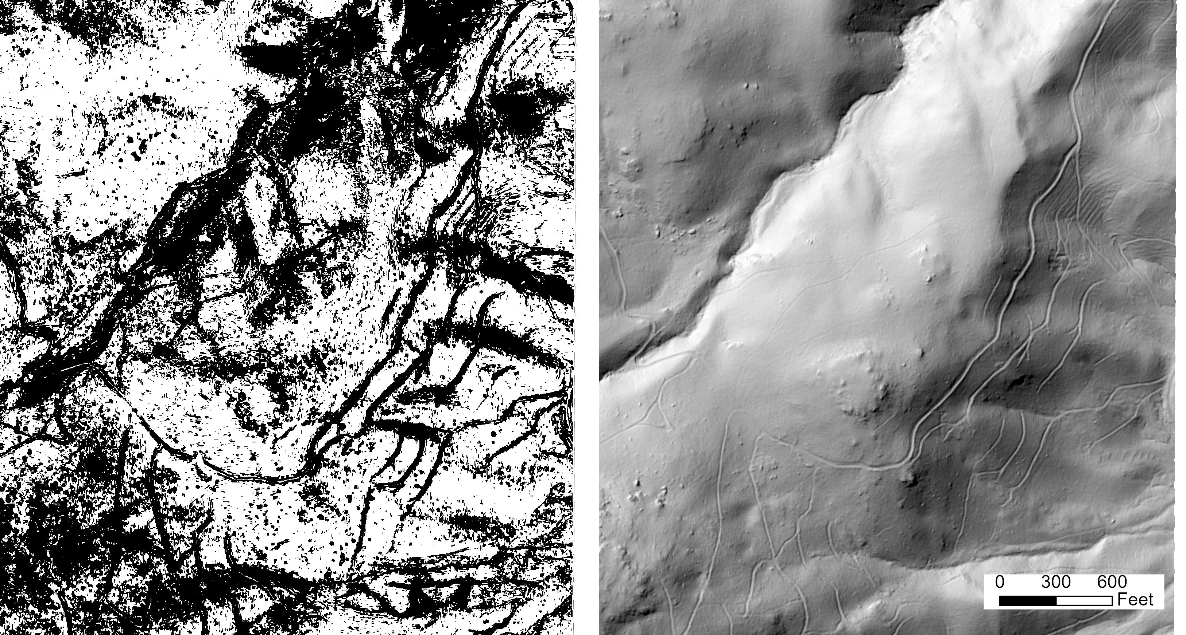
Results I
Misclassified features
Logging roads?

Slide 13
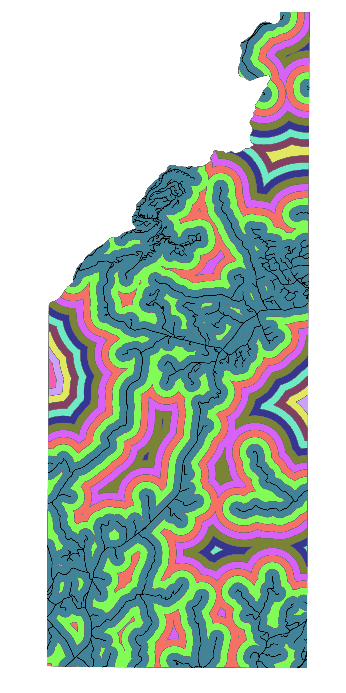
Results (Roads)
Could be skewed by smaller area

Slide 14
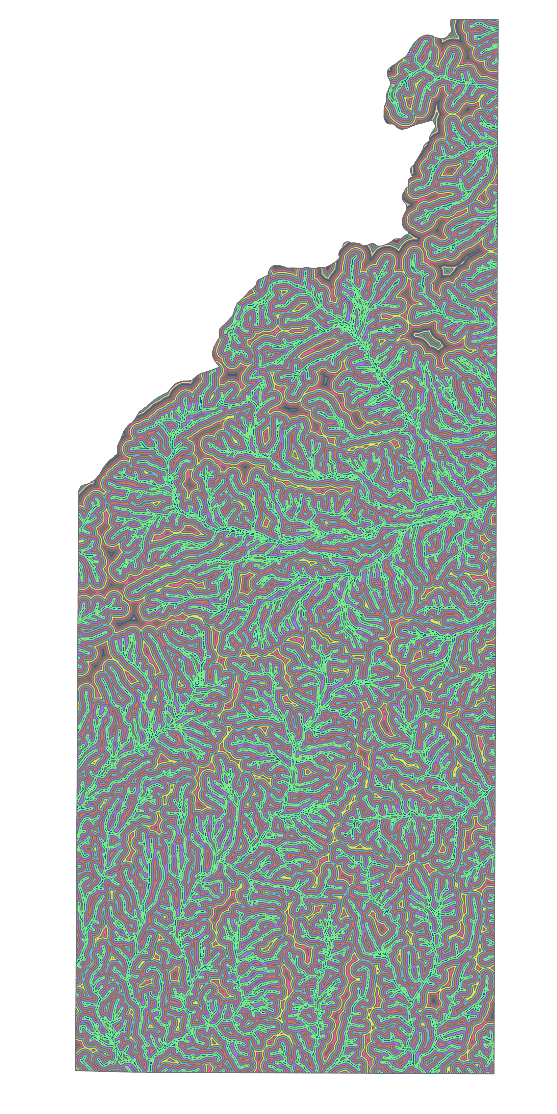
Results (Rivers)
Could be skewed by smaller area

Slide 15
Discussion
Overall high number of false positives means the 71.9% of correctly identified landslide features is not as useful.
The high number of false positives in the Sherando quad could be because more landslide training samples came from Horseshoe Mtn., a topographically different (steeper) quadrangle.
Correctly classified process points (91%) suggests an easier time classifying landslides where they initiate.
Slope movement outline polygons were drawn based in part from historical aerial imagery, which would show more of the landslide deposit than is visible in 2016 LiDAR.

Slide 16
Discussion
Including roads here was not useful
Publicly available road layers fail to capture more informal roads, e.g. logging roads. Road density may’ve looked different if it included these
For historical landslides, roads change in the intervening time
Already examined the probability of landslides being near rivers; next step is to examine the probability of rivers being near landslides.

Slide 17
Discussion III
Alternative Workflows
Object Based Image Analysis (OBIA)
Attempted here but classification not improved
Aerial imagery and change detection
Historical imagery shows extent of landslide deposits that have since been eroded, and no longer exist to be captured by LiDAR.
Original deposit extents key for inundation modeling
Additional or different DEM derivatives (e.g. Openness, Surface relief ratio)
Deriving these might require different software, toolboxes
A significance assessment would better inform the next modelling phase
Mask out obvious non-landslide areas from the beginning
Notes:
Assuming:
LiDAR is close enough to field verified for the process points and slope movement outlines
Geology is irrelevant
These are the best DEM derivatives

Slide 18
Conclusions
Classification would benefit from increased “non-landslide” training sample collection
Capture specific, discrete areas such as ponds, informal roads, and agricultural fields
“Landslide” training samples should be improved; currently they reflect deposit extents that have since been eroded
Future classifications may do well to focus only on the initiation points of landslide features
The relationship between landslide features and rivers needs further exploration; the road-landslide relationship needs to account for informal roads to be useful
Notes:
How many did I take?

